Slide 1
Introduction to Inflation and Unemployment in Macroeconomics
Understanding the Relationship between Inflation and Unemployment in the Field of Macroeconomics

Slide 2
What is Inflation?
Inflation is the sustained increase in the general level of prices for goods and services in an economy.
It is measured as an annual percentage increase and can erode the purchasing power of money over time.
Inflation can be caused by various factors such as increased demand, higher production costs, or changes in government policies.

Slide 3
What is Unemployment?
Unemployment refers to the number of people who are actively seeking employment but are currently without a job.
It is an important economic indicator that reflects the health of the labor market.
Unemployment can be caused by factors such as changes in economic conditions, technological advancements, or government policies.

Slide 4
The Phillips Curve
The Phillips Curve is a graphical representation of the inverse relationship between inflation and unemployment.
According to the Phillips Curve, as unemployment decreases, inflation tends to increase, and vice versa.
This relationship suggests that policymakers face a trade-off between reducing unemployment and controlling inflation.

Slide 5
Types of Inflation
There are different types of inflation that can occur in an economy.
Some common types include demand-pull inflation, cost-push inflation, and built-in inflation.
Understanding the causes and effects of different types of inflation is important for policymakers and economists.

Slide 6
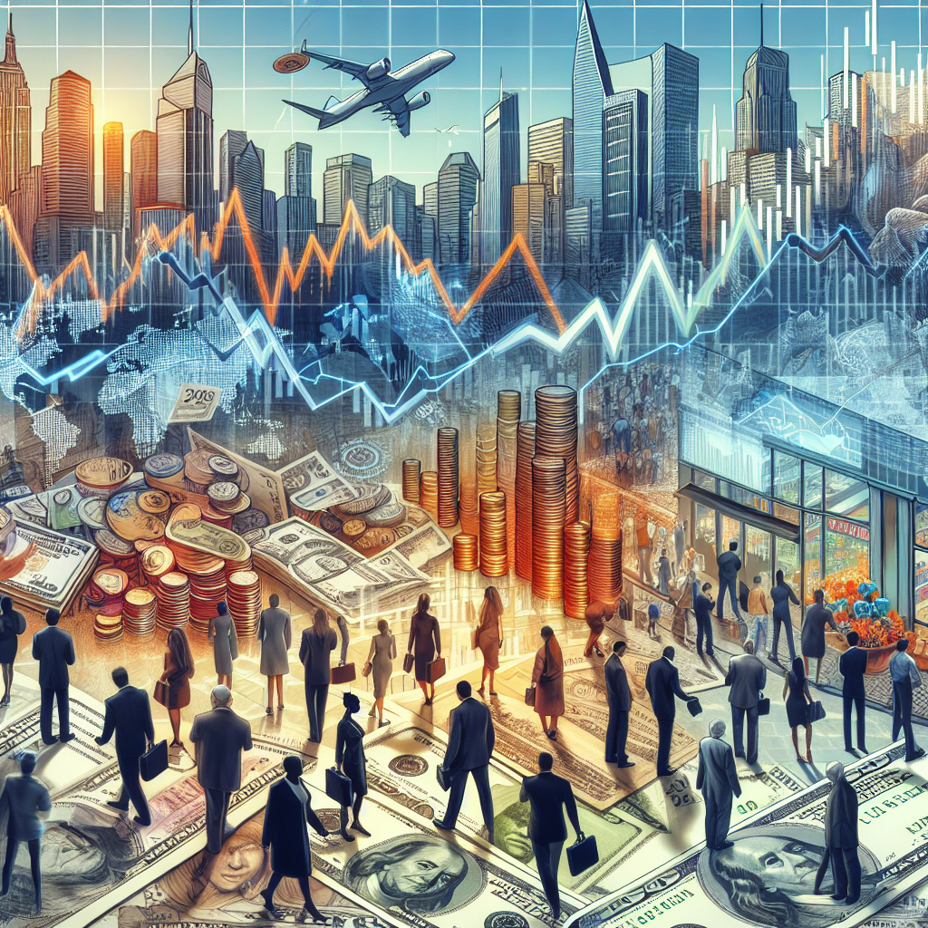
Causes and Consequences of Inflation
Inflation can have both positive and negative effects on an economy.
Some potential causes of inflation include excessive money supply, increased production costs, or changes in international trade.
Consequences of inflation can include decreased purchasing power, higher interest rates, and uncertainty in the business environment.
Inflation

Slide 7
Types of Unemployment
There are different types of unemployment that can occur in an economy.
Some common types include cyclical unemployment, structural unemployment, and frictional unemployment.
Understanding the causes and characteristics of different types of unemployment is important for policymakers and economists.

Slide 8
Natural Rate of Unemployment
The natural rate of unemployment refers to the level of unemployment that exists when the economy is considered to be at full employment.
It includes frictional and structural unemployment and represents the lowest level of unemployment achievable without causing inflation.
Economists and policymakers closely monitor the natural rate of unemployment to assess the health of the labor market.

Slide 9
Okun's Law
Okun's Law is an empirical relationship between changes in the unemployment rate and the rate of economic growth.
It suggests that for every 1% increase in the unemployment rate, there is a 2% decrease in the rate of economic growth.
Okun's Law highlights the negative impact of unemployment on economic performance.

Slide 10
Policy Implications
Understanding the relationship between inflation and unemployment is crucial for policymakers.
Policies aimed at reducing inflation may lead to an increase in unemployment, while policies targeting unemployment may contribute to higher inflation.
Finding the right balance between controlling inflation and promoting job creation is a key challenge for policymakers.

Slide 11
Recent Trends and Challenges
In recent years, many economies have faced the challenge of low inflation and high unemployment.
This phenomenon, known as stagflation, poses unique challenges for policymakers.
Finding effective strategies to stimulate economic growth and reduce unemployment in a low inflation environment is a priority for many countries.

Slide 12
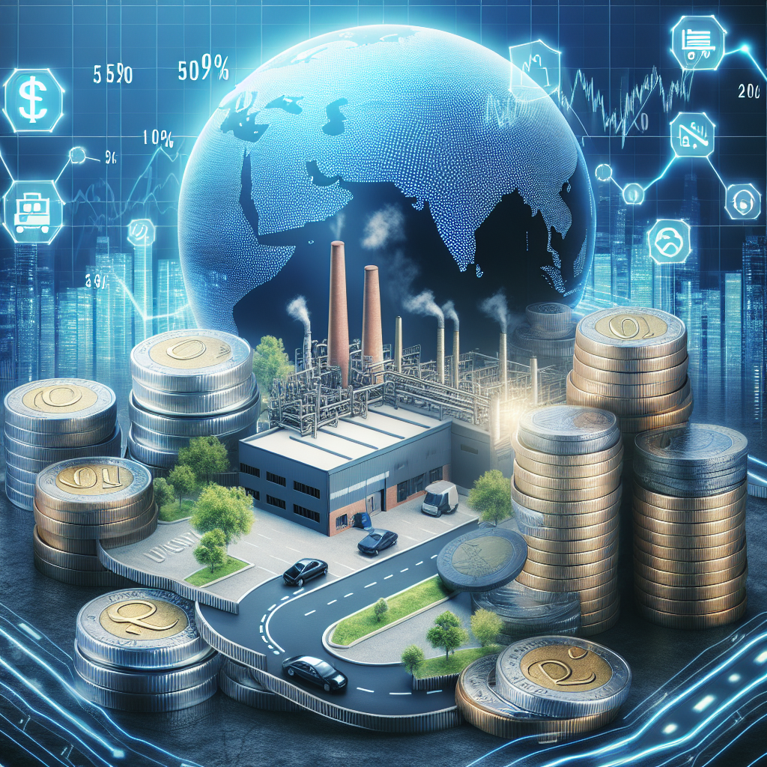
Conclusion
In conclusion, the relationship between inflation and unemployment is a key concept in macroeconomics.
Understanding the causes, consequences, and policy implications of inflation and unemployment is crucial for maintaining a stable and healthy economy.
By closely monitoring and managing inflation and unemployment, policymakers can strive to achieve sustainable economic growth and improved living standards for all citizens.
Macroeconomics

Slide 13
References
1. Blanchard, O. J., & Fisher, S. (1989). Lectures on Macroeconomics.
2. Mankiw, N. G. (2016). Macroeconomics.
3. Romer, D. (2011). Advanced Macroeconomics.

Slide 14
Thank You
Thank you for your attention!
Any questions?

